Slide 1
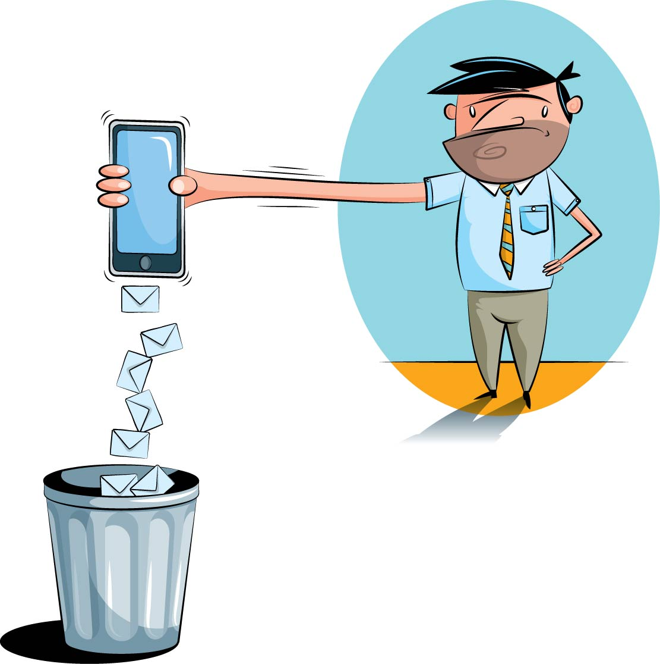
An Analysis of Spam SMS Features
Data Analysis and Research Project
Harshita Jain
n9539361
Supervisor: Dr. Guido Zuccon

Slide 2
Project Background and Context
92% of spam SMS are fraud
Overall rate of receipt grew by 300% from 2011 to 2012.
Mobile network operators suffer a loss
Higher network costs
Higher operating costs
Increased customer care costs
Tarnished reputation
Annoying for customers
Loss of confidential and valuable personal information
Source: http://arrow.dit.ie/cgi/viewcontent.cgi?article=1022&context=scschcomart

Slide 3
Gap in previous solutions
Simple solutions are used - Blacklisting and Spoofing/Faking Detection
Brittle by nature
Do not take content of messages into account
Require on-going management
Not much data available for research studies
Available datasets are different
Source: http://arrow.dit.ie/cgi/viewcontent.cgi?article=1022&context=scschcomart

Slide 4
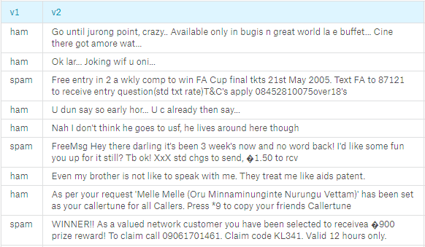
Data Set
Source: Kaggle

Slide 5
Project Purpose and Deliverables
Analyze the data to understand the differentiating features of Spam SMS.
Project Deliverables:
R Markdown
Analysis Report
Purpose of the Project
Source: https://cacm.acm.org/blogs/blog-cacm/169199-data-science-workflow-overview-and-challenges/fulltext

Slide 7
Thank You!!
Any questions?

Slide 8
References
Team, A. V., Shaikh, F., Jain, K., Gupta, A., & Gupta, D. (2016, October 11). A Complete Tutorial to learn Data Science in R from Scratch. Retrieved August 09, 2017, from https://www.analyticsvidhya.com/blog/2016/02/complete-tutorial-learn-data-science-scratch/
Guo, P. (2013, October 30). Data Science Workflow: Overview and Challenges. Retrieved August 09, 2017, from https://cacm.acm.org/blogs/blog-cacm/169199-data-science-workflow-overview-and-challenges/fulltext
Delany, S. J., Buckley, M., & Greene, D. (2012). SMS Spam Filtering: Methods and Data. Retrieved from http://arrow.dit.ie/cgi/viewcontent.cgi?article=1022&context=scschcomart
Whitepapers. (n.d.). Retrieved August 09, 2017, from https://www.cloudmark.com/en/s/resources/whitepapers/sms-spam-overview
(n.d.). Retrieved August 09, 2017, from https://archive.ics.uci.edu/ml/datasets/SMS Spam Collection
The DSDM Agile Project Framework (2014 Onwards). (2017, April 18). Retrieved August 09, 2017, from https://www.agilebusiness.org/resources/dsdm-handbooks/the-dsdm-agile-project-framework-2014-onwards

